Slide 1
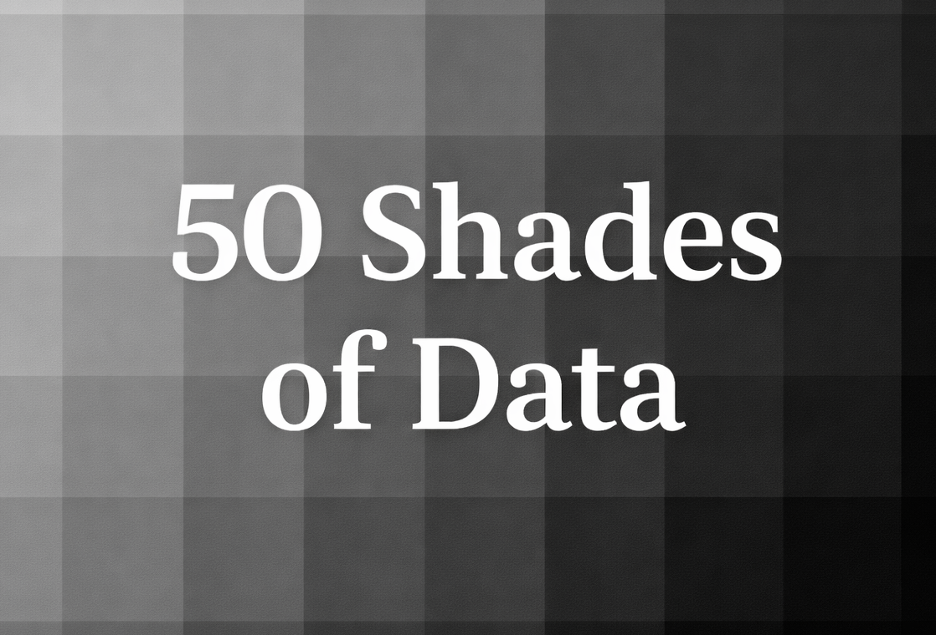

Group study project
Eniac’s Discount Strategy
by Marvin, Denys, Bengü, Stefano, Wadim

Slide 2


Conclusions
Discounts Are the Default:
2. Sweet Spot at 20–25%:
93%
of order lines are sold at a discount, signaling permanent markdowns rather than tactical promotions.
20%
Revenue peaks at moderate discounts; deeper cuts (>30%) fail to deliver incremental gains.
3. Revenue Is Event-Led:
4. Weak Daily Impact:
Sales spikes are driven by calendar moments (Black Friday, Q4), not discount depth.
Outside peak events, discount size has little influence on day-to-day revenue.

Slide 3
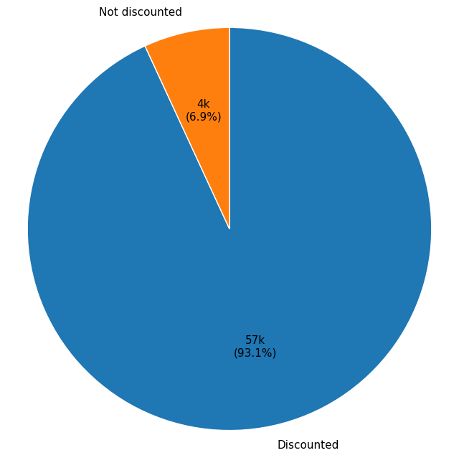
Eniac Performance Overview
93% of all items were sold at a discount, with an average discount depth of 21%.
Analysis Period: 2017 – 2018
179
Total Brands
Representing the full portfolio of brands sold by Eniac
46.6k
Completed Orders
Total number of successfully processed transactions
12.9M
Total Revenue
Gross sales generated during the analyzed period
Source: Eniac Historical Sales Database (2017–2018)

Slide 4
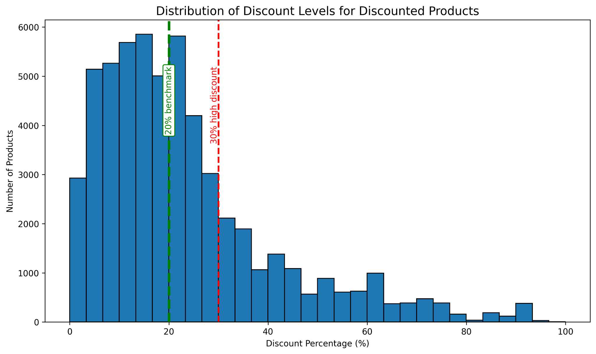
Low discount levels dominate, while high discounts are uncommon
Healthy Discounting: Most clusters below 20%
Rare Extremes: Discounts >30% form a thin long tail
Risk: High-discount promotions are exceptional and pose margin risks
Source: Eniac Historical Sales Database (2017–2018)

Slide 5
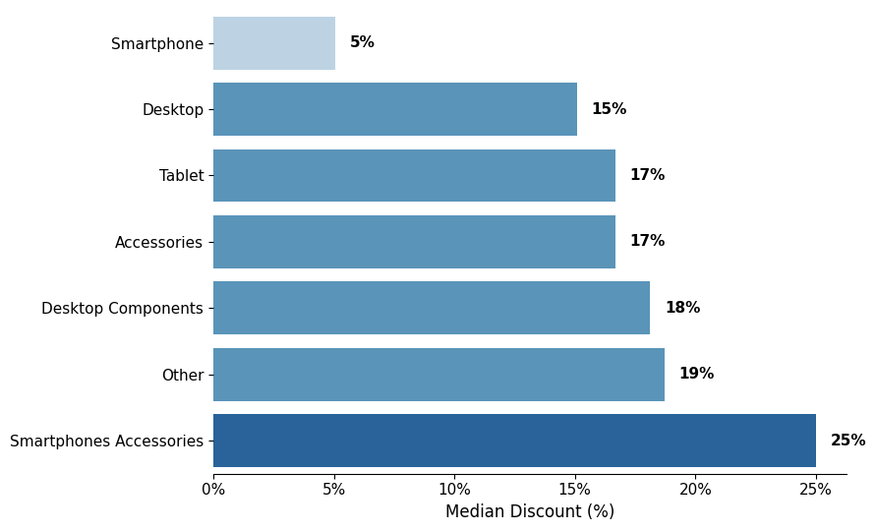
Pricing power stays with core products while accessories drive demand
Accessories show the widest discount spread (up to ~80%), indicating aggressive pricing for traffic acquisition and upselling.
Smartphones have minimal discounts (median ~5%), acting as premium anchor products with strong turnover even at near-full price.
Source: Eniac Historical Sales Database (2017–2018)

Slide 6
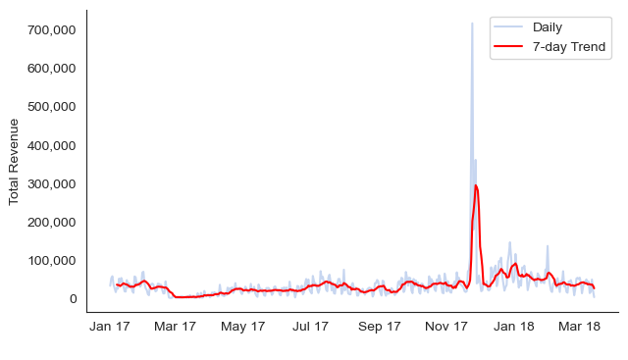
Black Friday spike dominates annual sales, highlighting high seasonal dependency.
Off-season demand remains flat despite high discount levels.
Promotional resources should be concentrated on seasonal peaks rather than year-round discounting.
Source: Eniac Historical Sales Database (2017–2018)

Slide 7
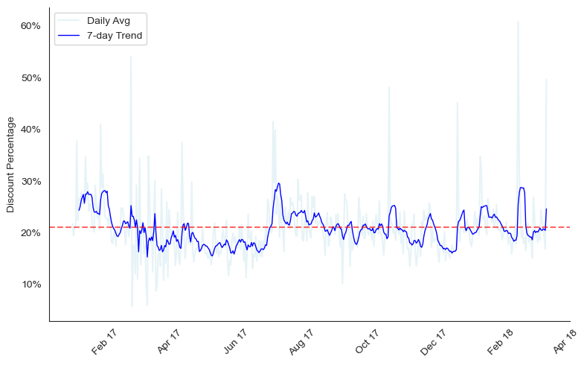
Revenue growth stems from event timing rather than discount depth. Success lies in the tandem of seasonal demand and tactical discounting.
Discounts act as constant demand management, peaking in effectiveness during Q4.
Recommendation:
Lower off-peak discounting to reclaim margin, as daily volume is insensitive to price depth.
Source: Eniac Historical Sales Database (2017–2018)

Slide 8
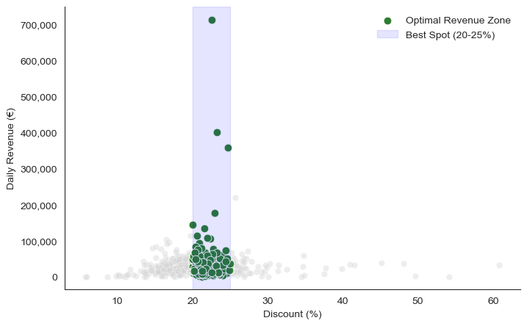
Discounts drive volume primarily during high-seasonality peaks, while everyday correlation remains low.
Maximum revenue is achieved at 20-25% discount depth.
Going beyond 30% does not yield proportional growth.
Source: Eniac Historical Sales Database (2017–2018)

Slide 9
Recommendations
Event-Driven Strategy: Shift budget to high-seasonality events (Black Friday, Q4) where discounts are most effective.
Reduce "Always-On" Discounts: Lower the 30% discount coverage during off-peak periods and concentrate on the 20-25 % range which has the highest revenue, to protect our profit margins.
Tiered Approach: Maintain Smartphones as premium margin anchors (min. discounts) while using Accessories as the actual traffic magnets and upselling tools (aggressive discounts).
High collaborative work with marketing: Identify trends, ebbs and flows through the data with marketing to implement high impact discount strategies.

Slide 10
thank you
No pandas were harmed during the analysis process. 🐼

Slide 11
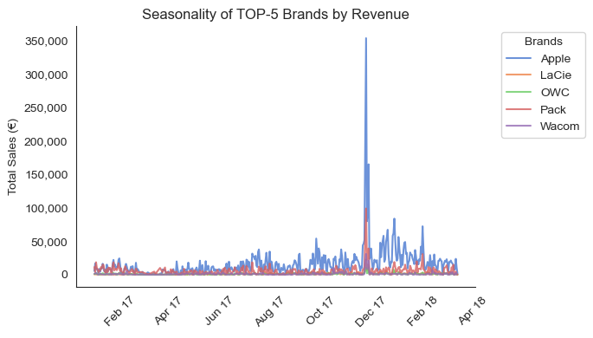
Apple products are the main driver of revenue throughout the year and the seasonal period
Apple's main sources of revenue - desktop and tablet categories.
During non-seasonal periods, the emphasis on categories is little blurred.
Source: Eniac Historical Sales Database (2017–2018)
Notes:
*Most discounts cluster below 20% (benchmark range)
*Discounts above 30% are rare - higher risk overcrowding the slide

Slide 12
Conclusions
Discounts Are the Default: 93% of order lines are sold at a discount, signaling permanent markdowns rather than tactical promotions.
Sweet Spot at 20–25%: Revenue peaks at moderate discounts; deeper cuts (>30%) fail to deliver incremental gains.
Revenue Is Event-Led: Sales spikes are driven by calendar moments (Black Friday, Q4), not discount depth.
Weak Daily Impact: Outside peak events, discount size has little influence on day-to-day revenue.

